Slide 1
Educational Data Mining | Predictive Analytics | R Programming
Student Performance Analytics
A Data-Driven Study Using R Programming
Research Report Presentation
Dataset: 6,607 Students | 20 Variables | R Statistical Software
Presentation by: Bibi Pari Gul
STUDENT PERFORMANCE ANALYTICS

Slide 2
Problem Statement, Objectives, and Scope
05
Problem Statement
Research Objectives
Educational institutions struggle to identify the major factors influencing student performance and lack data-driven intervention strategies.
● Perform exploratory data analysis
● Identify significant correlations
● Build regression models
● Predict pass/fail outcomes
● Classify students using clustering
Research Scope
Dataset: 6,607 students
Variables: 20 (7 numerical, 13 categorical)
Software: R Programming
Cleaned: 6,378 observations
Research Framework
Data Collection → Cleaning → EDA → Modeling → Evaluation → Recommendations

Slide 3
Statistical Techniques
08
Descriptive Statistics: Summarize and describe dataset characteristics
Describe
Descriptive statistics
Correlation Analysis: Measure relationships between variables
Correlate
Linear Regression: Model continuous outcome predictions
Correlation analysis
Logistic Regression: Predict binary outcomes (pass/fail)
Model
Regression models
Cluster Analysis: Identify natural student groupings
Key Insight: Regression predicts outcomes, clustering identifies groups, and classification improves interventions.
Cluster
Cluster analysis

Slide 4
Dataset Description
10
6,607
6,378
20
Total Observations
Cleaned Dataset
Variables
Initial student records collected
After removing incomplete records
7 numerical + 13 categorical
Key Variables Included
Variable | Type | Variable | Type
Hours Studied | Numerical | Attendance | Numerical
Sleep Hours | Numerical | Previous Scores | Numerical
Motivation Level | Categorical | Exam Score | Numerical

Slide 5
Data Cleaning and Preprocessing
11
Data Cleaning Steps
Missing Values Summary
1
Converted categorical variables into factors
Variable | Missing Values
Teacher_Quality | 78
Parental_Education_Level | 90
Distance_from_Home | 67
2
Checked missing values using is.na()
3
Removed incomplete observations using na.omit()
4
Created pass/fail binary outcome variable
Final Dataset: 6,378 observations after cleaning (96.5% retention rate)

Slide 6
Statistical Techniques Used
12
Analytical Methods
Assumption Tests
Descriptive Statistics
Correlation Analysis
Test | Purpose
VIF | Multicollinearity detection
Residual Analysis | Model fit assessment
QQ Plot | Normality check
Cook's Distance | Outlier detection
Shapiro-Wilk | Normality test
Linear Regression
Logistic Regression
Cluster Analysis
Important Finding: Shapiro-Wilk normality test could not be performed because the sample size exceeded 5,000 observations.

Slide 7
Descriptive Statistics
14
Variable | Mean | SD | Skewness | Kurtosis
Hours Studied | 19.98 | 5.99 | 0.01 | 0.02
Attendance | 79.98 | 11.55 | 0.01 | -1.19
Sleep Hours | 7.03 | 1.47 | -0.02 | -0.50
Previous Scores | 75.07 | 14.40 | 0.00 | -1.19
Tutoring Sessions | 1.49 | 1.23 | 0.82 | 0.64
Physical Activity | 2.97 | 1.03 | -0.03 | -0.06
Exam Score | 67.24 | 3.89 | 1.64 | 10.56
Interpretation
Exam Score shows positive skewness (1.64)
High kurtosis (10.56) indicates outliers
Tutoring moderately skewed (0.82)
Attendance near-normal distribution

Slide 8
Frequency Distribution Analysis
15
Key Observations: The dataset is predominantly male (57.7%) from public schools (69.6%). Motivation levels are highest in the Medium category (52.5%), suggesting most students maintain moderate engagement.

Slide 9
Histogram and Boxplot Analysis
16
Histogram Findings
Exam scores follow a positive distribution
Most scores concentrated around 65-70
Boxplot Findings
Outliers present in exam scores
Extreme observations above upper whiskers
Outlier Detection Methods: Boxplot method used for visual identification; Cook's Distance applied to detect influential observations in regression analysis.

Slide 10
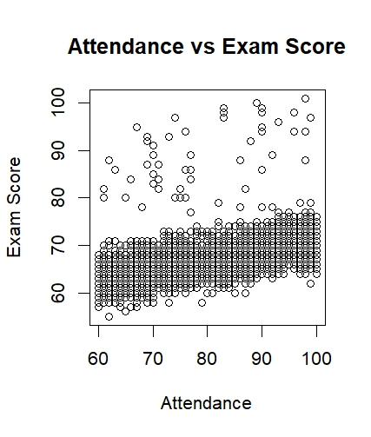
Scatterplot Analysis
17
Key Findings
Attendance vs Exam Score
Positive relationship observed between attendance and exam performance.
Study Hours vs Performance
Study hours show the strongest association with exam outcomes.
Previous Scores vs Outcome
Previous scores moderately related to current exam results.
Insight: All three predictors show positive linear trends with exam scores.

Slide 11
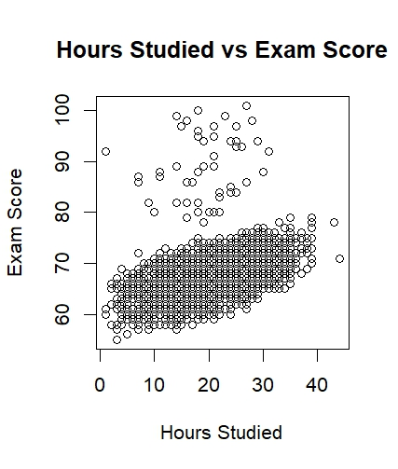
Scatterplot Analysis
17
Key Findings
Attendance vs Exam Score
Positive relationship observed between attendance and exam performance.
Study Hours vs Performance
Study hours show the strongest association with exam outcomes.
Previous Scores vs Outcome
Previous scores moderately related to current exam results.
Insight: All three predictors show positive linear trends with exam scores.

Slide 12
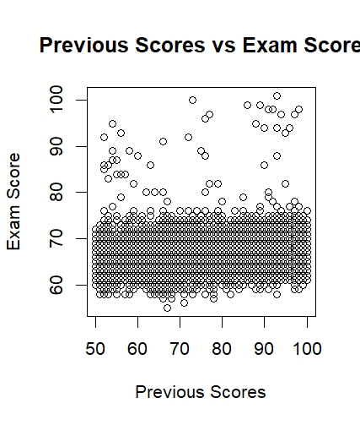
Scatterplot Analysis
17
Key Findings
Attendance vs Exam Score
Positive relationship observed between attendance and exam performance.
Study Hours vs Performance
Study hours show the strongest association with exam outcomes.
Previous Scores vs Outcome
Previous scores moderately related to current exam results.
Insight: All three predictors show positive linear trends with exam scores.

Slide 13
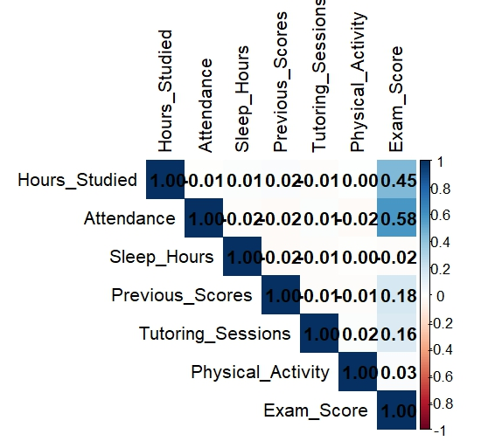
Correlation Analysis
18
Correlation Results
Variable | Correlation
Attendance | 0.58
Hours Studied | 0.45
Previous Scores | 0.18
Tutoring Sessions | 0.16
Physical Activity | 0.03
Sleep Hours | -0.02
Key Insight: Attendance has the strongest correlation (0.58) with exam scores. Sleep hours show minimal relationship (-0.02).

Slide 14
Linear Regression Analysis
19
Regression Equation
Exam_Score = 40.82 + 0.291(Hours_Studied) + 0.198(Attendance) + 0.048(Previous_Scores) + 0.494(Tutoring_Sessions) + 0.136(Physical_Activity)
Model Statistics
0.5937
0.5934
< .001
R-squared
Adjusted R-squared
p-value
Significant Predictors
Attendance
Hours Studied
Tutoring Sessions

Slide 15
Multicollinearity Test (VIF)
20
Variable | VIF
Hours Studied | 1.0006
Attendance | 1.0010
Previous Scores | 1.0010
Tutoring Sessions | 1.0007
Physical Activity | 1.0009
Interpretation
VIF Rule of Thumb:
● VIF = 1: No correlation
● VIF < 5: Low multicollinearity
● VIF > 10: High multicollinearity
Conclusion: All VIF values are close to 1 (range: 1.0006 - 1.0010). No multicollinearity issue detected. The regression model predictors are independent.

Slide 16
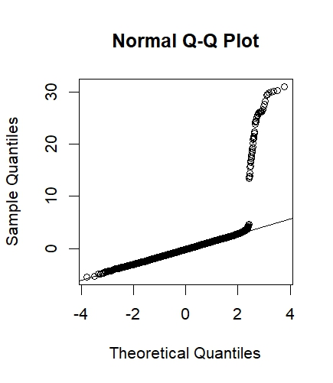
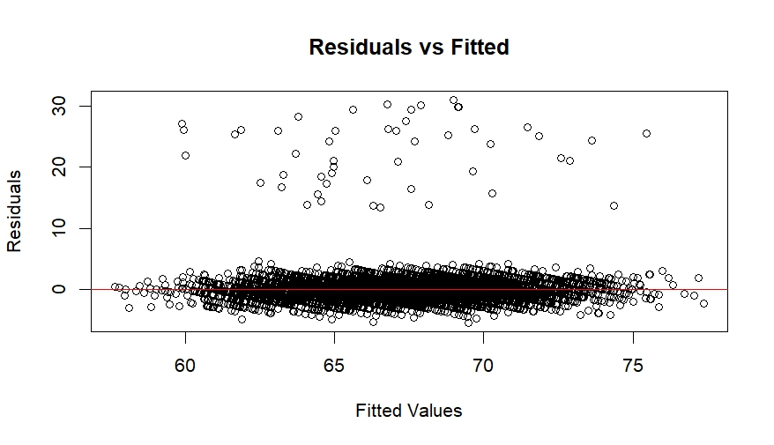
Residual Diagnostics and Assumption Testing
21
Tests Performed
Residual Histogram
QQ Plot
Residuals vs Fitted
Cook's Distance

Slide 17
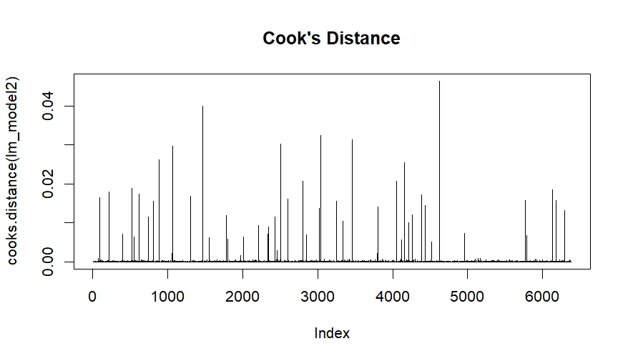
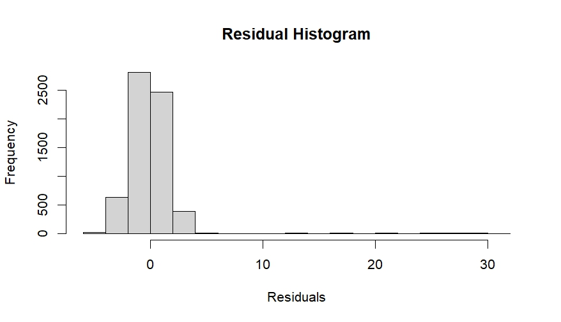
Residual Diagnostics and Assumption Testing
21
Tests Performed
Residual Histogram
QQ Plot
Residuals vs Fitted
Cook's Distance

Slide 18
Residual Diagnostics and Assumption Testing
21
Tests Performed
Residual Histogram
QQ Plot
Residuals vs Fitted
Cook's Distance
Test Results
Residuals are approximately normally distributed
Outliers detected through Cook's Distance analysis
Shapiro-Wilk test failed due to n > 5,000
Conclusion: Despite slight outliers, regression assumptions are reasonably satisfied. The model is valid for inference.

Slide 19
Logistic Regression Analysis
22
Odds Ratio Interpretation
Variable | Odds Ratio
Tutoring Sessions | 1.82
Hours Studied | 1.42
Attendance | 1.27
Physical Activity | 1.19
Previous Scores | 1.06
Key Finding: Tutoring sessions greatly improve passing probability (OR=1.82). Each additional tutoring session increases odds of passing by 82%.

Slide 20
Classification Matrix and ROC Curve
23
Confusion Matrix
ROC Curve Results
Predicted \ Actual | Fail | Pass
Fail | 2,326 | 423
Pass | 442 | 3,187
Accuracy | 86.3%
0.9446
Area Under Curve (AUC)
Excellent classification accuracy
Classification Metrics
86.3%
88.3%
84.6%
88.3%
Accuracy
Sensitivity
Specificity
Precision
Conclusion: The logistic regression model demonstrates excellent classification accuracy with AUC = 0.9446, indicating strong predictive power for pass/fail outcomes.

Slide 21
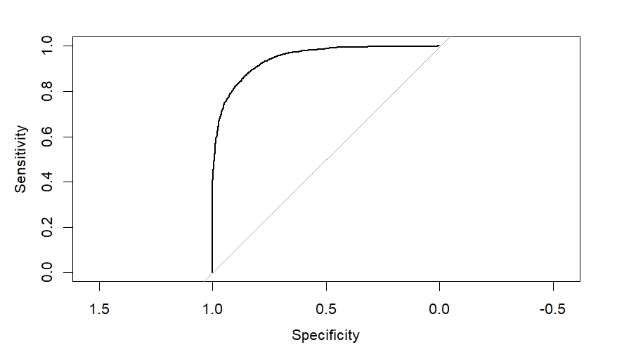
Classification Matrix and ROC Curve
23
Confusion Matrix
ROC Curve Results
Predicted \ Actual | Fail | Pass
Fail | 2,326 | 423
Pass | 442 | 3,187
Accuracy | 86.3%
0.9446
Area Under Curve (AUC)
Excellent classification accuracy
Classification Metrics
86.3%
88.3%
84.6%
88.3%
Accuracy
Sensitivity
Specificity
Precision
Conclusion: The logistic regression model demonstrates excellent classification accuracy with AUC = 0.9446, indicating strong predictive power for pass/fail outcomes.

Slide 22
Cluster Analysis
24
Clustering Method
Cluster Results
Gower Distance
Cluster | Students | Mean Exam Score
1 | 3,826 | 67.12
2 | 1,905 | 67.68
3 | 647 | 66.78
Hierarchical Clustering
Ward.D2 Method
3,826
1,905
647
Note: Three distinct student groups identified. Cluster 2 shows highest mean exam score (67.68), while Cluster 3 has the lowest (66.78).
Cluster 1
Cluster 2
Cluster 3
Mean Score: 67.12
Mean Score: 67.68
Mean Score: 66.78
60.0% of students
29.9% of students
10.1% of students

Slide 23
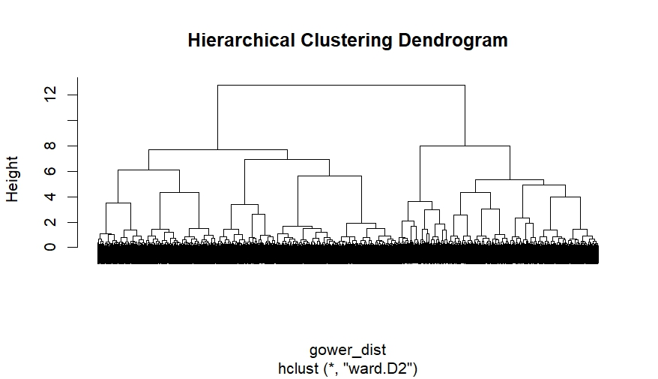
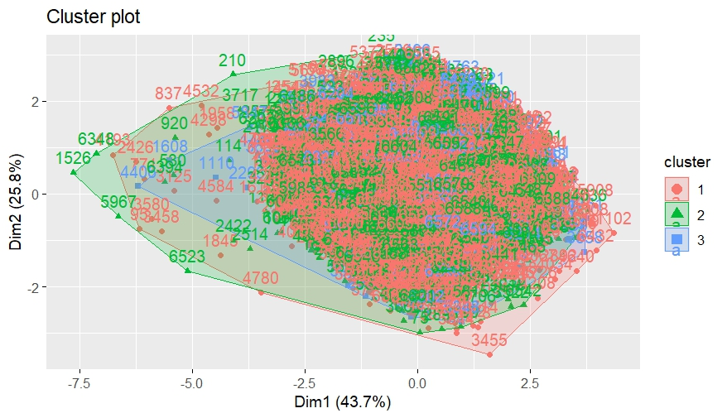
Cluster Analysis
24
Clustering Method

Slide 24
Conclusion
26
Major Findings
Attendance is the strongest predictor of exam performance
Study hours positively influence academic performance
Tutoring sessions improve student success rates
Logistic regression achieved excellent accuracy (AUC = 0.9446)
Cluster analysis identified three distinct student groups
Overall Conclusion
Educational analytics effectively explains academic performance patterns. The integration of multiple statistical techniques provides a comprehensive understanding of factors influencing student success.

Slide 25
Thank You
Student Performance Analytics
A Data-Driven Study Using R Programming | Educational Data Mining
Dataset: 6,378 Students | 20 Variables | 5 Chapters
Student Performance Analytics Research | Predictive Modeling in Education

